Slide 1
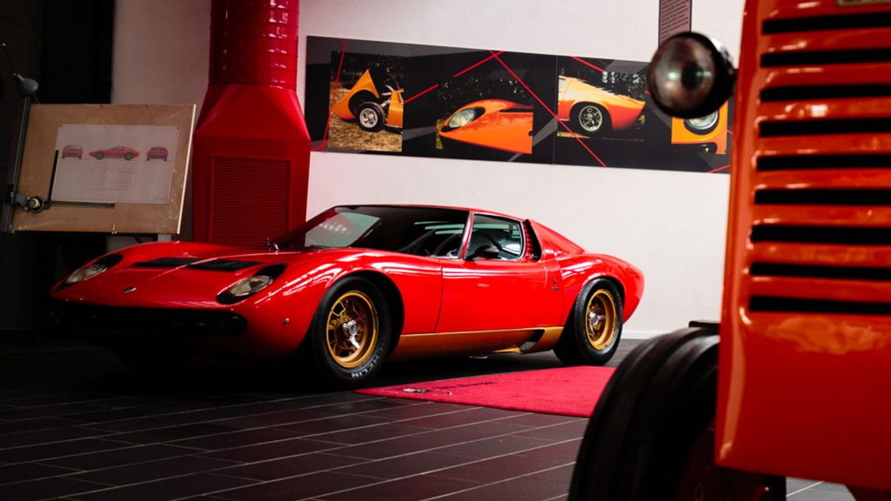
Ferruccio Lamborghini
Student’s Name
Institution

Slide 2
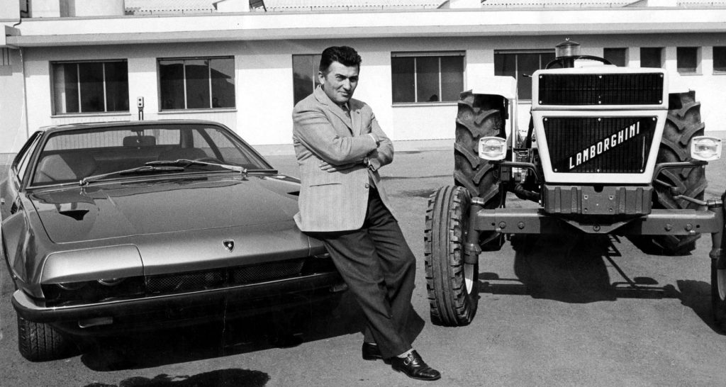
Biography
Born on April 28th 1916 in Italy
Born in a family of farmers
But, he preferred mechanics
Started working in Bologna and later got a contract for the Army
Improved his mechanical skills during World War II
Notes:
The man and legend of the sports car manufacture, Ferruccio Lamborghini was born in Italy in1916. Unlike his family who practiced farming, Lamborghini developed interest in mechanics, which he spent his early years sharpenning. However, the Second World War provided him with the opportunity to sharpen his skills as he worked in various cars.

Slide 3
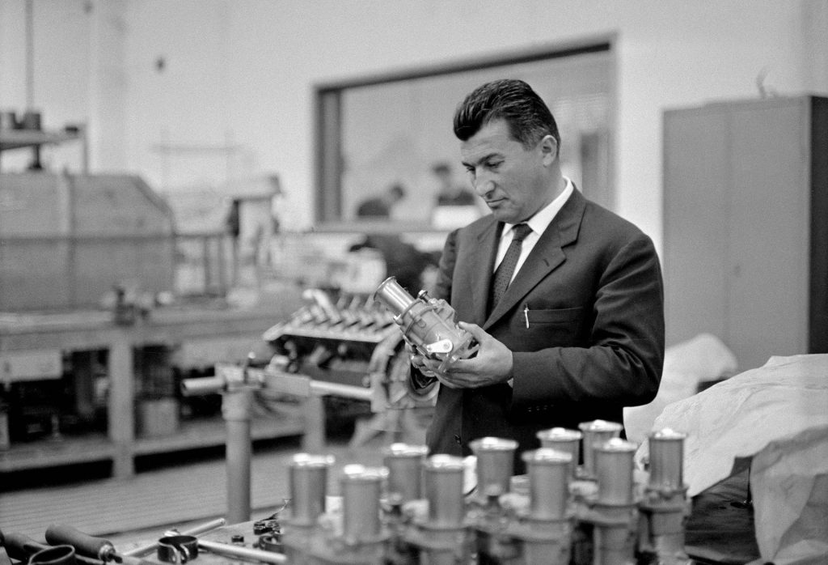
Continuation Biography
His entrepreneurial life started as the demand for agribusiness took shape in Italy
In 1948, he founded Lamborghini tractor
He managed the company with his wife, Annita Borgatti
In 1963, he founded
Automobili Ferruccio
Lamborghini Company
Notes:
The famous sports car, Lamborghini emerged in the early 1960s after Ferruccio Lamborghini established a company manufacturing tractors. Lamborghini sports car businesses became a viable dream for Ferruccio Lamborghini because the tractor business was doing well. It was until the end of 1960s that it became apparent that the pioner of Lamborghini company could not hold it for long.

Slide 4
Famous Quotes
Some of the famous quotes of Ferruccio Lamborghini include:
“When you stop working, you start to die.”
“I had never stopped thinking about ideal motor car…all I had to do was to construct a plant to built it.”
“I slammed the door and vowed I would build my own car-the way I wanted it.”
Notes:
Ferruccio Lamborghini was famous with his motivational and captivating quotes. Among his famous quotes include “when you stop working, you start to die” and many others. All these quotes have remained relevant even today and they still serve a great purpose to the upcoming leaders.

Slide 5
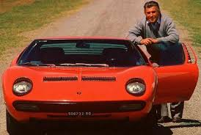
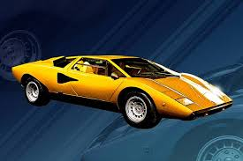
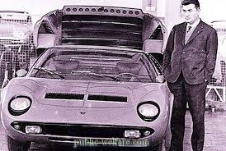
Leadership Details
Lamborghini was a visionary leader
Built his leadership on trust
Defined by creativity-he designed the famous lamborghini sports car
Openness and adaptability
Notes:
Despite that he had several challenges which inhibited his vision of lamborghini automobili company, Lamborghini was a visionary leader who saw the world in his own way. He came up with the lamborghini car after finding the other cars inefficient. He identified the inefficiency in the market and sought to address it. His creativity enabled him to design a car that would soon become the world’s famous model. His ability to adapt to circumstances enabled him go through the challenges and come out the other side.

Slide 6
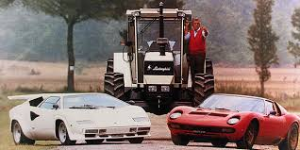
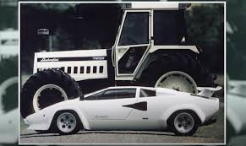
Challenges/Failures
Unpredictability of the market
Launched lamborghini car too soon
Lack of enough market for products
Including tractors
High cost of management
Notes:
Lamborghini did not anticipate the uncertainty in the market, which resulted in the huge inventory with inadequate market. Business environment is very uncertain and nothing symbolizes this like Lamborghini’s entrepreneurial life. Managing the high cost of operations became a great challenge for Lamborghini, especially after failing to sell more than 5,000 tractors as he planned. He eventually stopped at sports car, which became difficult to manage a few years later, resulting in its auction. Lamborghini could not withstand the effects of the dynamic market.

Slide 7
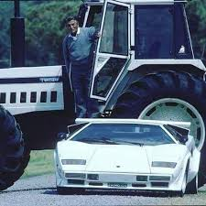
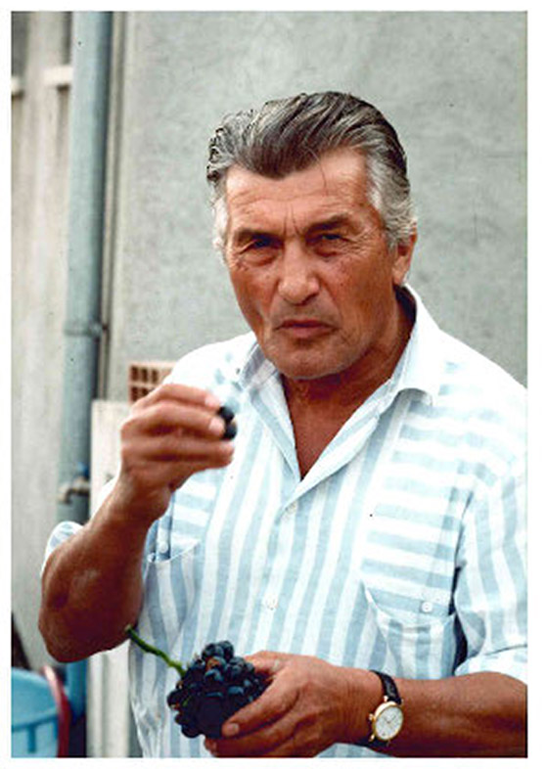
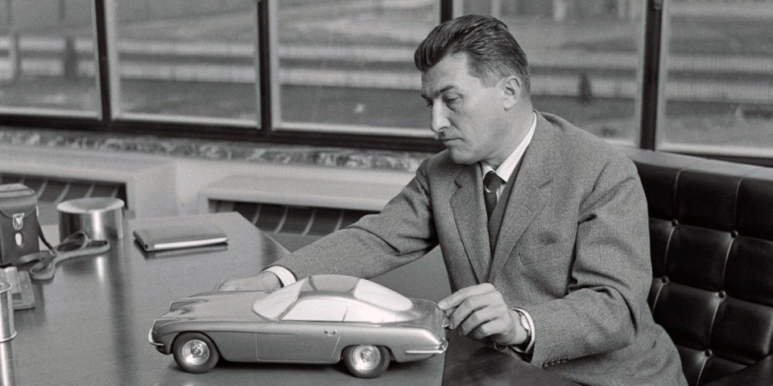
Resolving the Challenges
Creativity
Auctioned the tractor business
He no longer felt tune with the market
Sold 51% of the shares and later the rest (motor valley)
Notes:
Lamborghini faced many challenges including the financial crisis created by the influx inventory from the unsold tractors. Even in the midst of the challenges his creativity never stopped. Some leaders may wait until they become bankrupt, but Lamborghini used his creativity to solve the situation with the options that he had. As such, he sold 51% of the tractor business shares and later the rest that remained. In 1971, Lamborghini sought to retire and leave the entrepreneurial life. As a solution, he sold all the shares of the company and retired to his home and focused his attention on farming.

Slide 8
Reference
Motor valley stories. Ferruccio Lamborghini: A dream challenge. Retrieved from https://motorvalley.it/en/story/ferruccio-lamborghini-a-dream-challenge/

